Slide 1
Funding Determination Workshop
Let’s shed some light on an often-scary subject

Slide 2
Agenda
Who’s In the Room
Fill Out A Sample Form
Mitigating Circumstances
Questions

Slide 3
I. Who’s in the room and what is a funding determination form
Let's set expectations and get to know each other better

Slide 4

Presenters
Jason Sitomer – Managing Director
jsitomer@charterimpact.com
Jim Surmeian – Director of Client Finance
jsurmeian@charterimpact.com
Danielle Vartanian – Accounting Manager
dvartanian@charterimpact.com

Slide 5
Who is in the Room?
Are you running a homeschool, independent study, fully virtual, or some other model?
Does your school submit using SACs coding or the Alternative Form?
Who has completed a Funding Determination Form before?
  How many have you completed?
Is this completed internally, or do you utilize a back-office/ consultant?
Have you ever had to apply for mitigating circumstances?
What other interesting/weird situations have you come across?

Slide 6
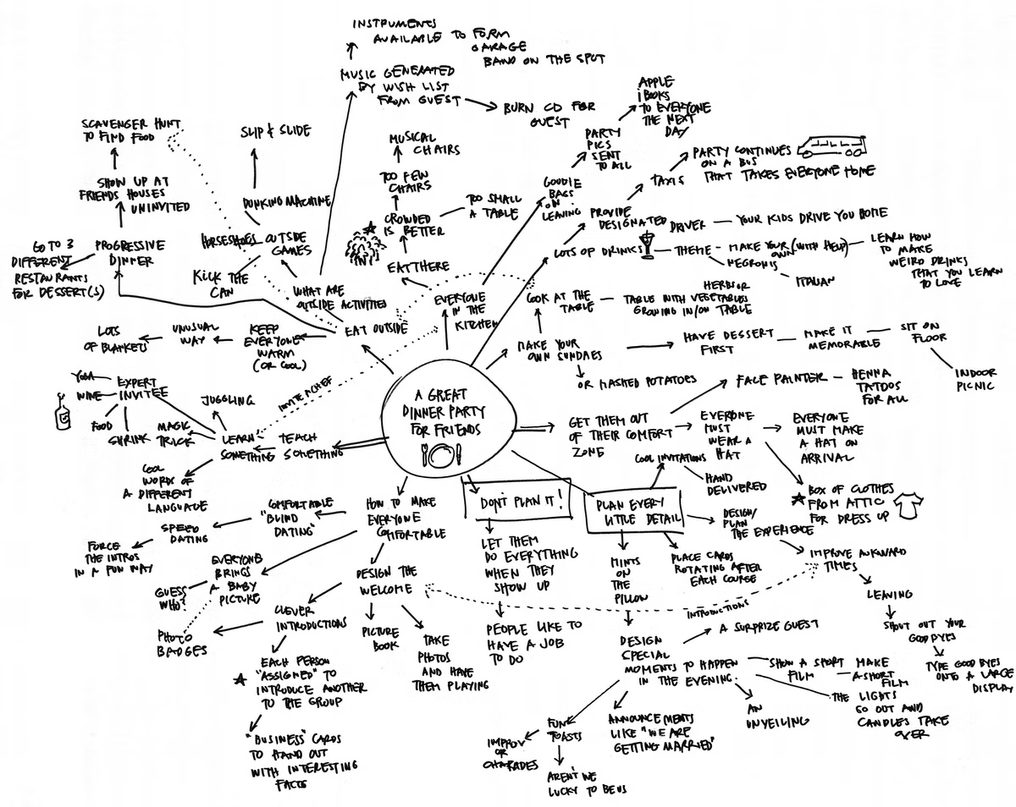
What are Today’s Goals

Slide 7
Why does a Funding Determination Form Exist
SB740 (Senate Bill 740) was passed in Oct’ 2001. It was created to give stronger governmental oversight on Flex-Based programs
It added transparency by including the disclosure of board members, top vendors, and any conflicts of interest
Implementation was turbulent in the first several years and the process has changed many times since its implementation
The goals and the results of this program have likely been underwhelming, as it has never caught any bad actors because of this additional step (or at least that I could find in my research)

Slide 8
What is a Funding Determination Form
A requirement for Flex-Based Charters only
  SB740 means something completely different to a classroom-based program
It determines a school’s funding levels by measuring the certificated spending, instructional spending, and a school’s PTR (Pupil Teacher Ratio)
  It is attempting to vet for bad actors and ensure funds are not syphoned away from schools
It limits a school's surplus to be (likely) 10% or less
  Again, this is only a limitation on Flex-Based programs

Slide 9
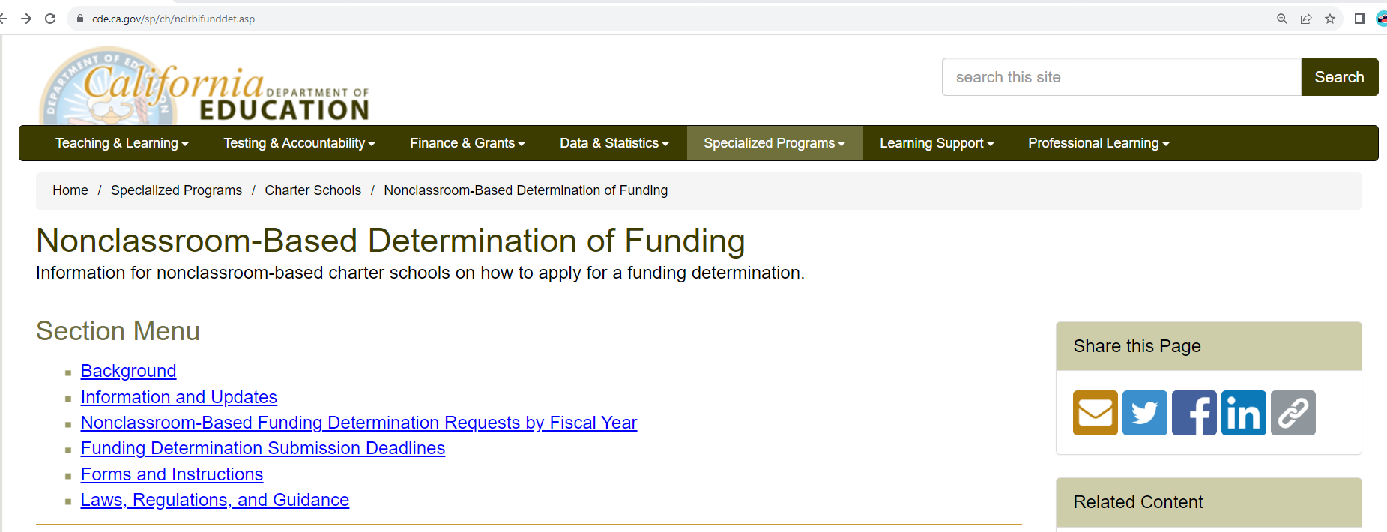
Where is a Funding Determination Form
Its online ☺
  https://www.cde.ca.gov/sp/ch/nclrbifunddet.asp

Slide 10
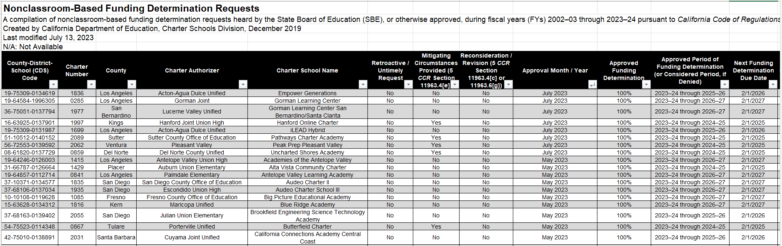
What’s on the website?
An Excel of when all schools is up for renewal and their current funding information

Slide 11
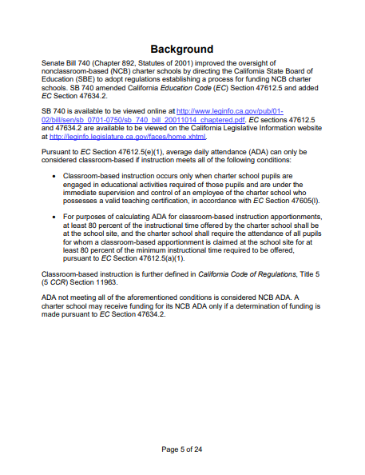
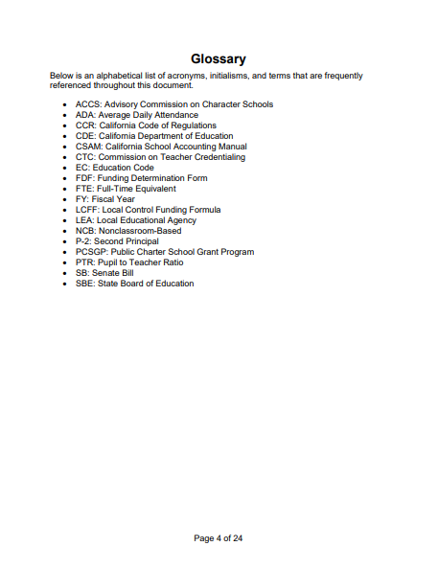
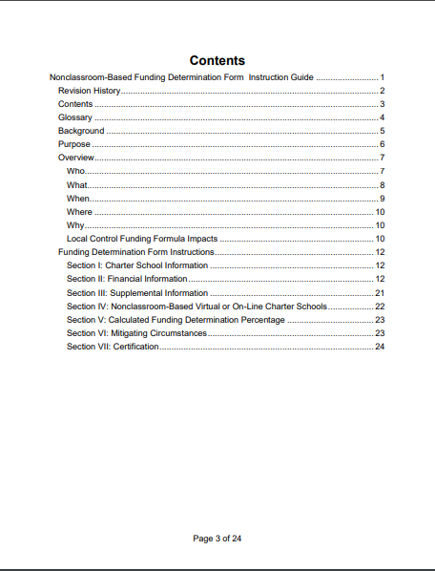
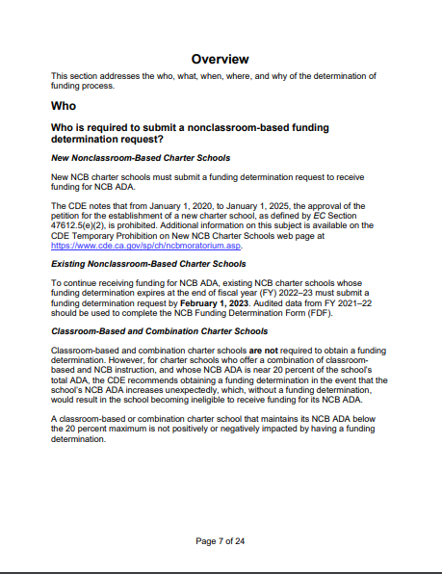
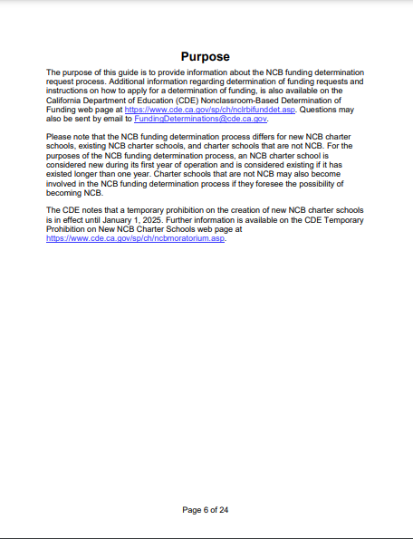
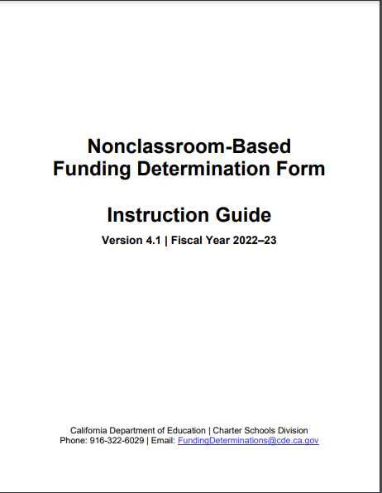
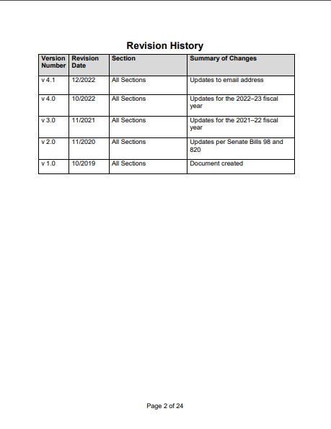
What’s on the website?
A 26-page PDF with instructions on how to fill out the funding determination form

Slide 12
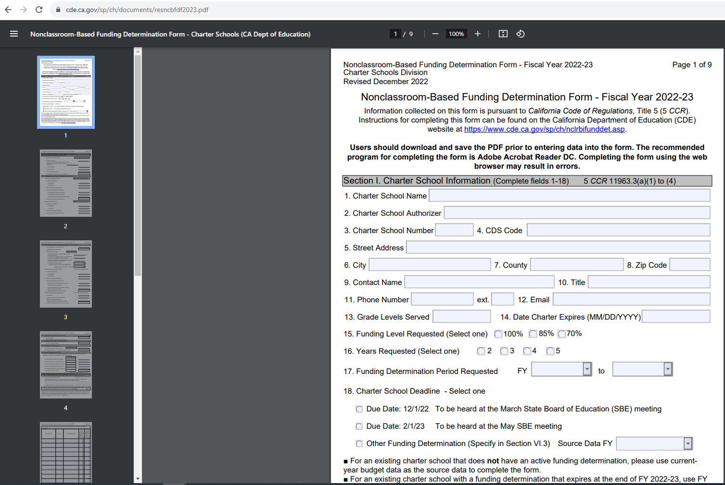
What’s on the website?
The 9-page editable Funding Determination Form editable template
A new version is released annually
A new version is released annually (around December), so always use the most recent version

Slide 13
How the FDF is measured
40%
40%
Often referred to as the 40/80 measurement

Slide 14
How the FDF Works in Reality
18%
47%
35%
82%

Slide 15
How the FDF Works in Reality
14%
51%
35%
86%

Slide 16
Funding Determination – 40/80

Slide 17
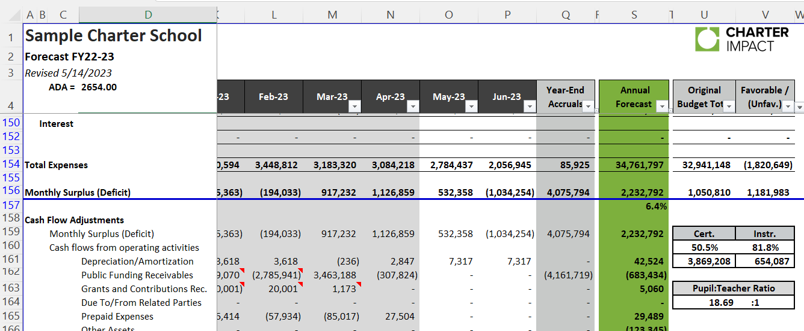
How to prepare for a funding determination year
PLAN AND TRACK!

Slide 18
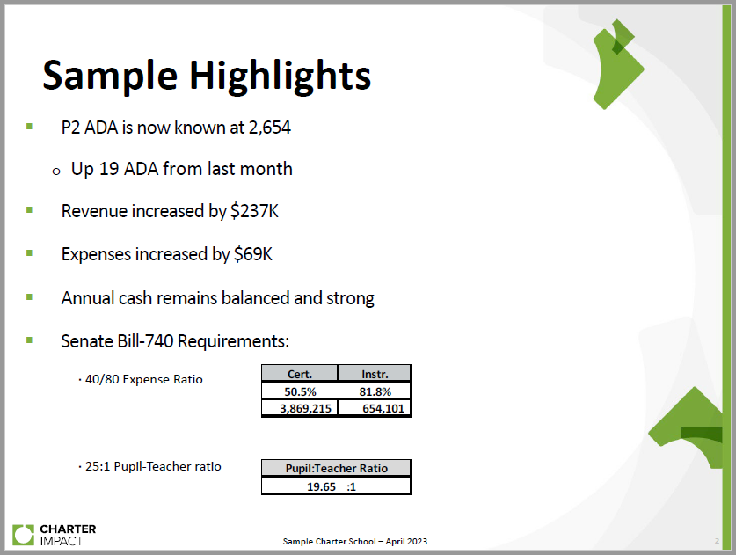
How to prepare for a funding determination year
Know what year you need to apply and provide transparency to your board

Slide 19
II. Filling Out A Sample Form
Let’s break it down into digestible bits

Slide 20
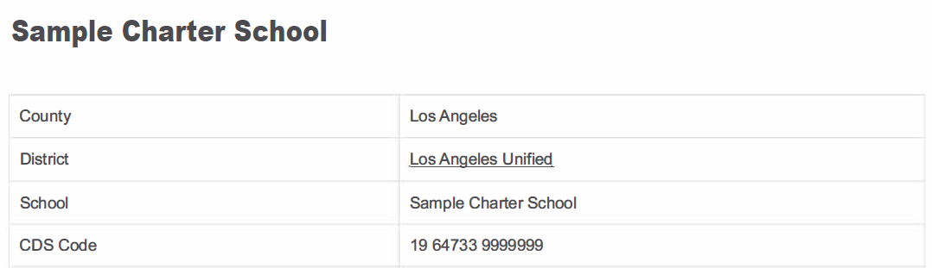
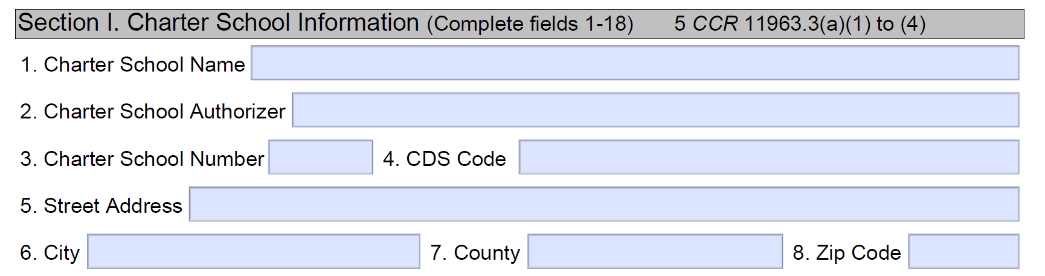
Page 1 – General Info

Slide 21
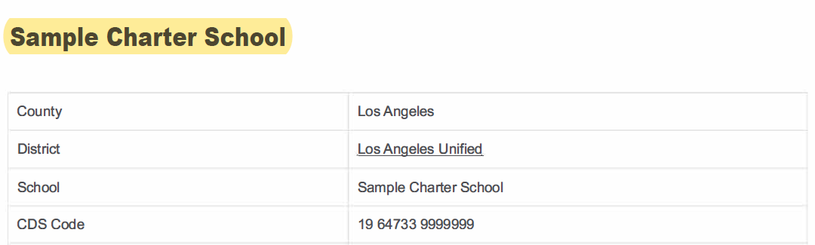
Page 1 – General Info
1
Sample Charter School

Slide 22
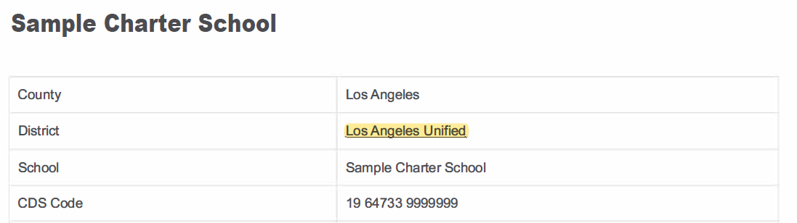
Page 1 – General Info
2
Sample Charter School
Los Angeles Unified School District

Slide 23
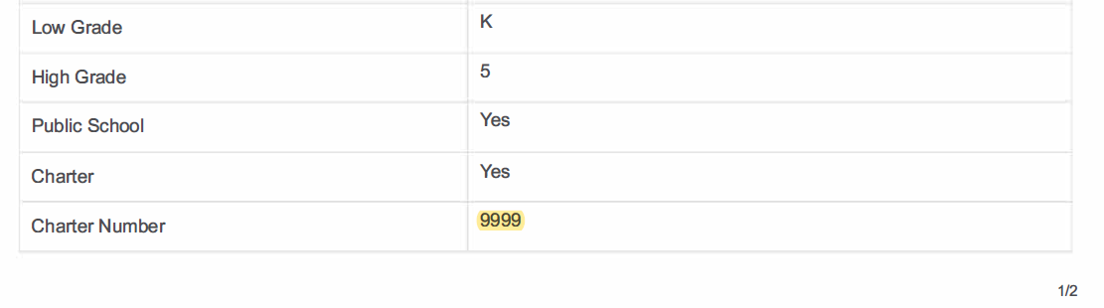
Page 1 – General Info
3
Sample Charter School
Los Angeles Unified School District
9999

Slide 24
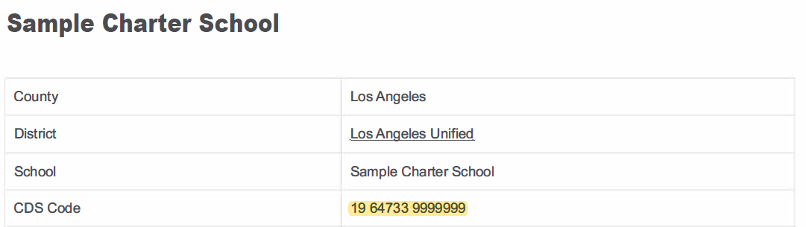
Page 1 – General Info
4
Sample Charter School
Los Angeles Unified School District
9999
19 64733 9999999

Slide 25
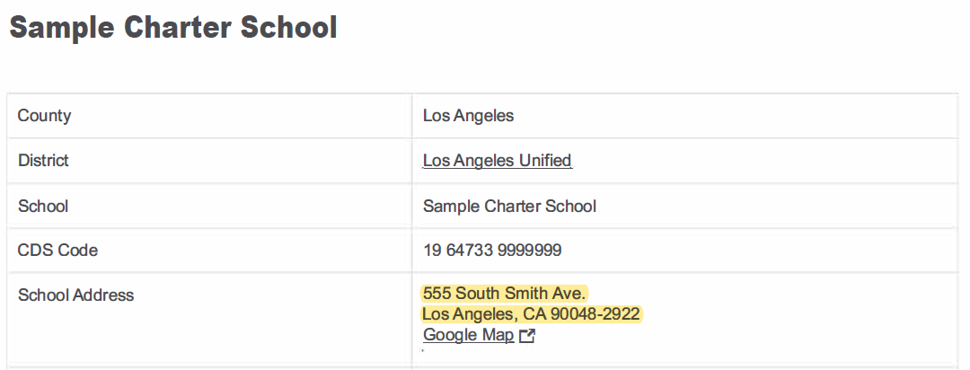
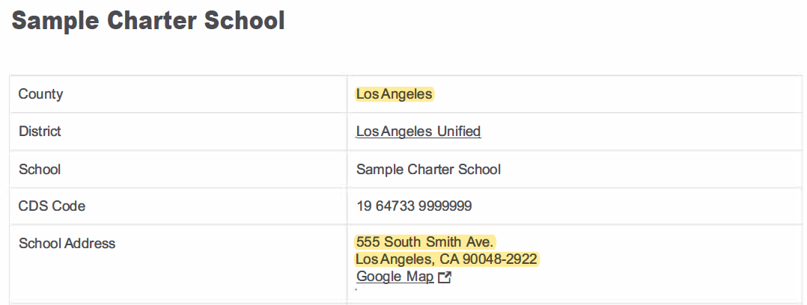
Page 1 – General Info
7
5
6
8
Sample Charter School
Los Angeles Unified School District
9999
19 64733 9999999
555 South Smith Ave.
Los Angeles
Los Angeles
90048-2922

Slide 26
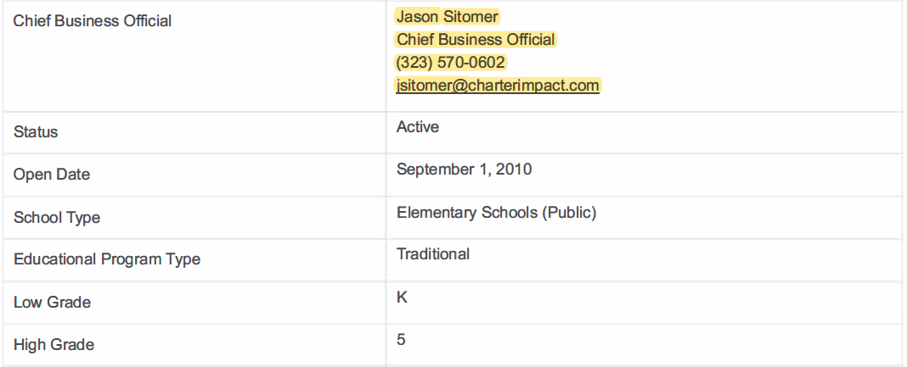
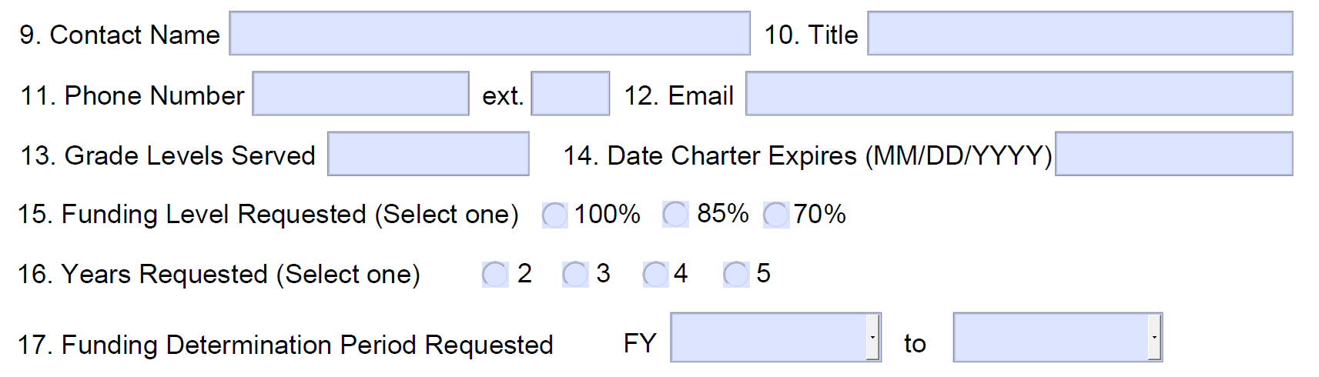
Page 1 – General Info
9
10
11
12
Jason Sitomer
Chief Business Official
323-570-0602
jsitomer@charterimpact.com

Slide 27
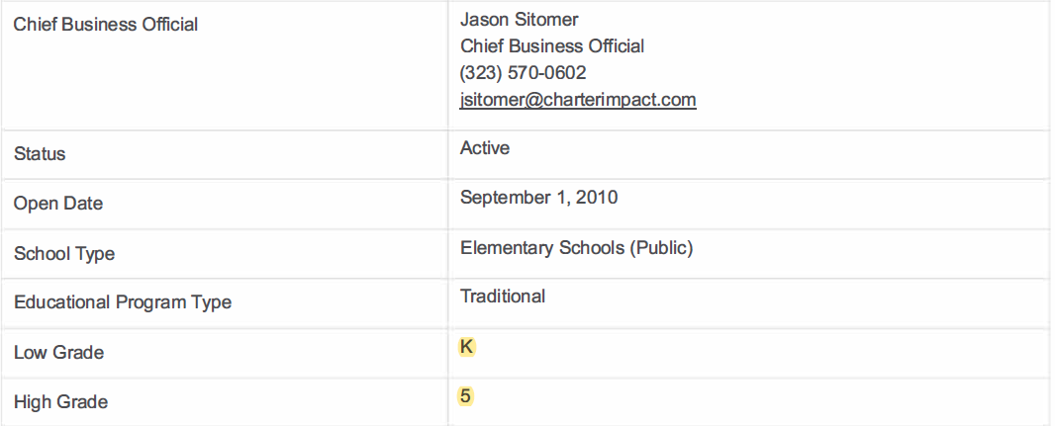
Page 1 – General Info
13
Jason Sitomer
Chief Business Official
323-570-0602
jsitomer@charterimpact.com
K-5

Slide 28
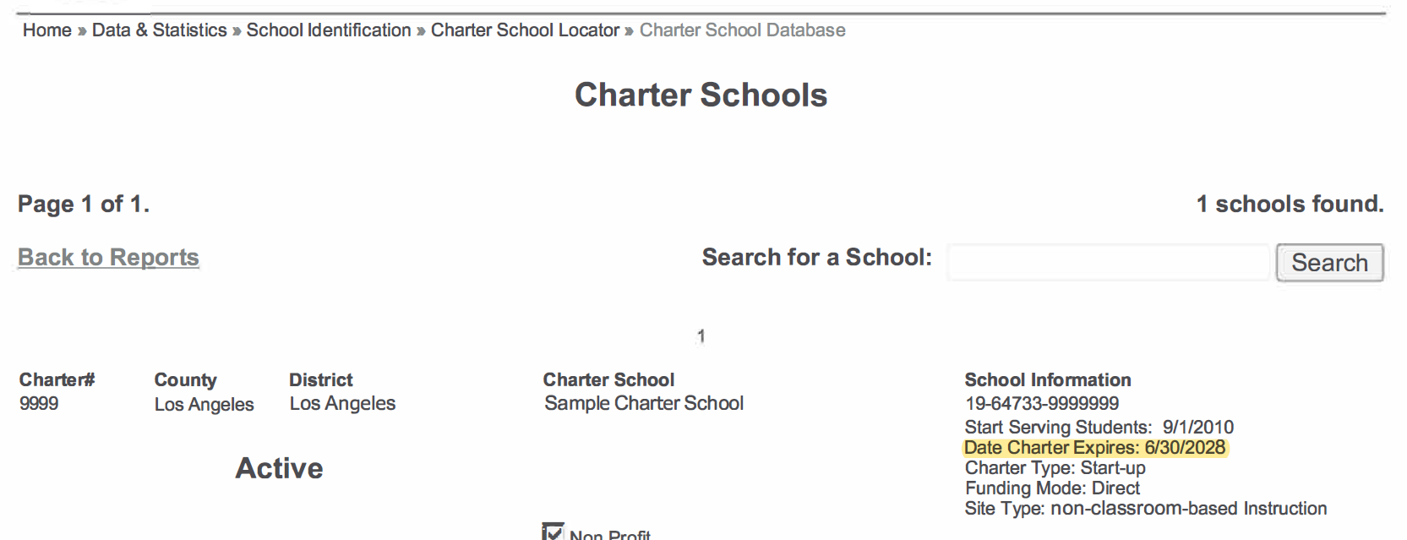
Page 1 – General Info
https://www.cde.ca.gov/ds/si/cs/ap/lists.asp
14
Jason Sitomer
Chief Business Official
323-570-0602
jsitomer@charterimpact.com
K-5
06/30/2028

Slide 29
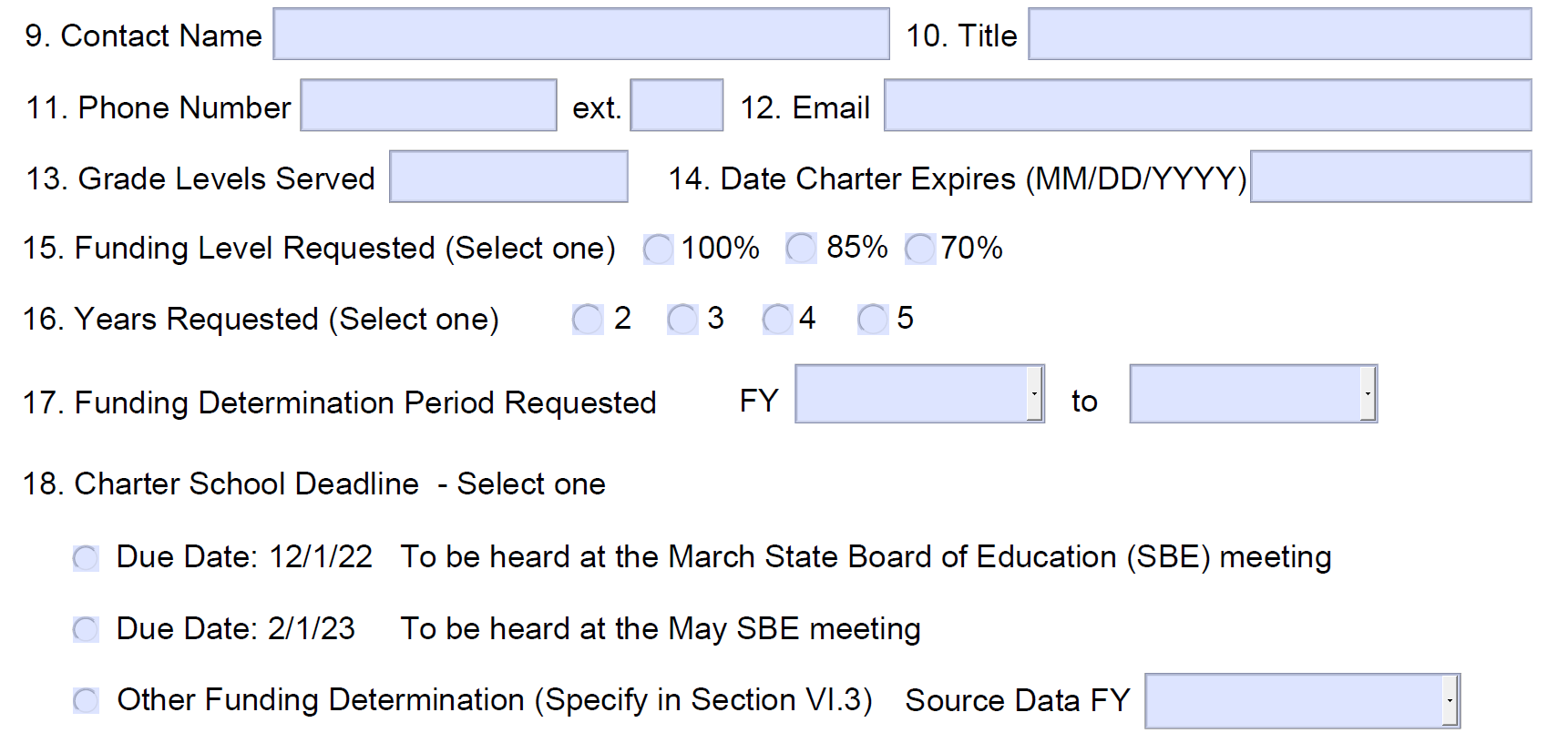
Page 1 – General Info
Jason Sitomer
Chief Business Official
323-570-0602
jsitomer@charterimpact.com
K-5
06/30/2028
24-25
28-29
New Schools = 2 years
First renewal = 3 years
Second renewal = 4 years

Slide 30
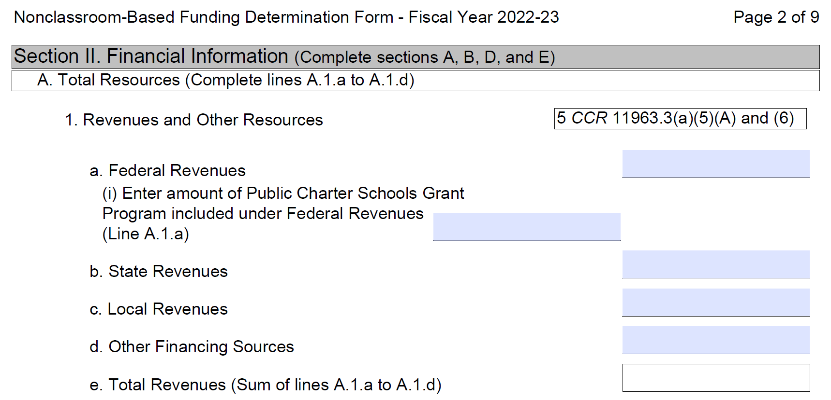
Page 2 through 4 – Financial Info

Slide 31
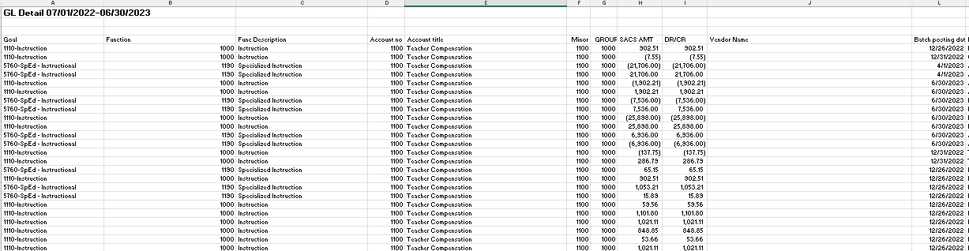
Page 2 through 4 – Financial Info
If using SACS coding….
Run your audited GL Details

Slide 32
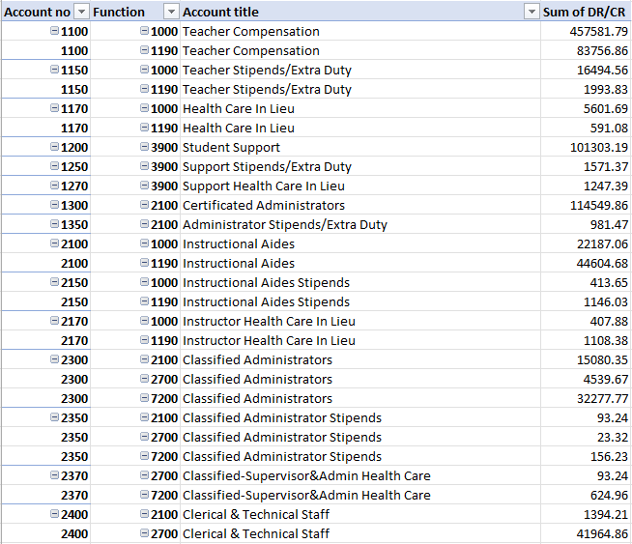
Page 2 through 4 – Financial Info
If using SACS coding….
Pivot this information to capture the Obj-Function Combinations:

Slide 33
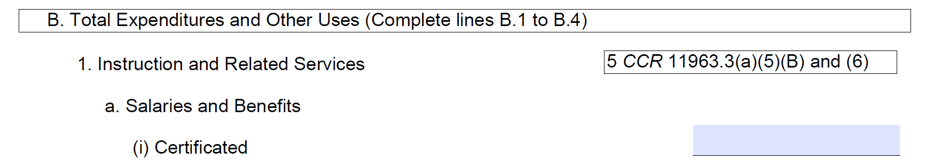
Page 2 through 4 – Financial Info
If using SACS coding….
Create a workbook that will group these into the specific categories utilized in the Funding Determination Form:
Example:
If an object code starts with “1,” FDF code will be B1a(i)
If an object code starts with “3” and ends with “1,” FDF code will be B1a(i)
If a contracted service / sub-agreement are for SPED, FDF code will be B1a(i)

Slide 34
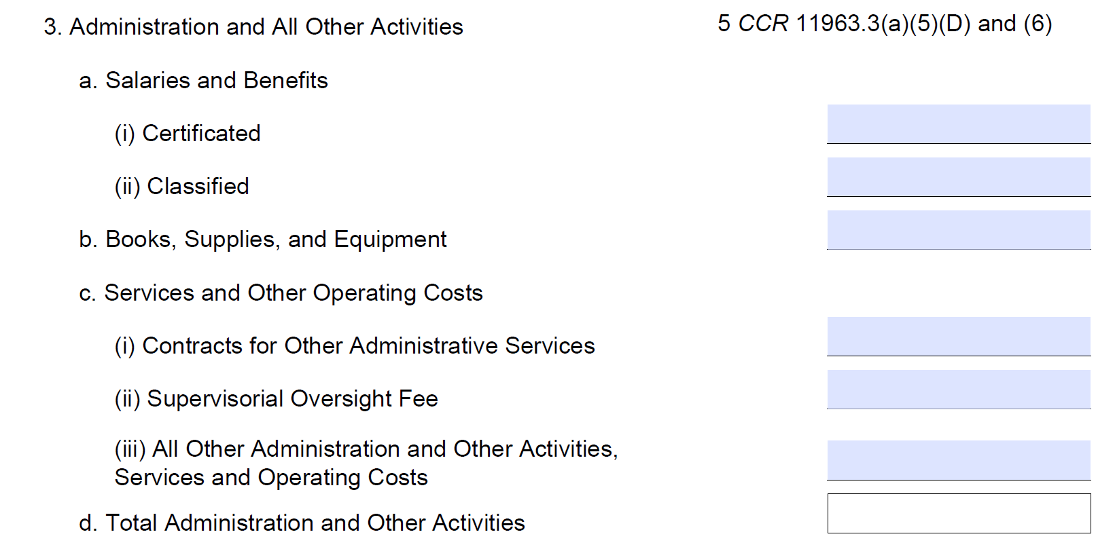
Page 2 through 4 – Financial Info
If using SACS coding….
Example:
All expenses with function codes of 6000 or higher will be in the administrative 3rd section

Slide 35
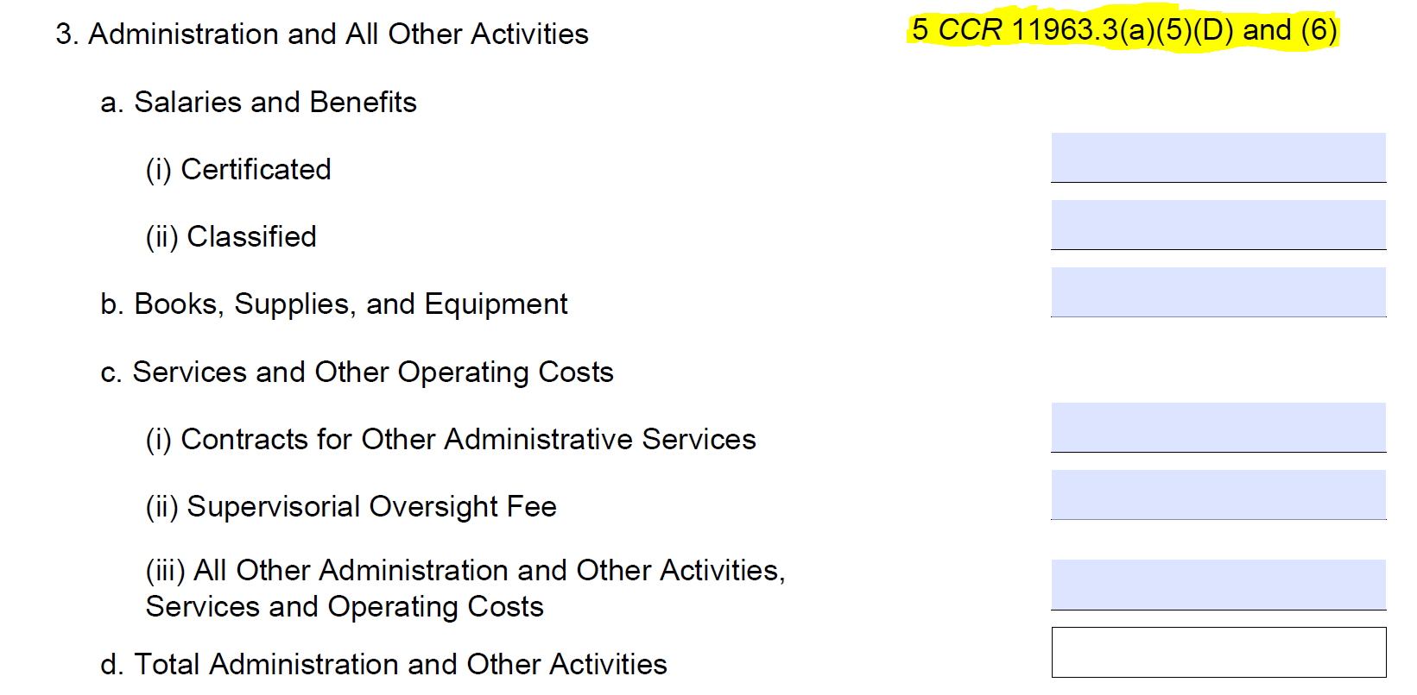
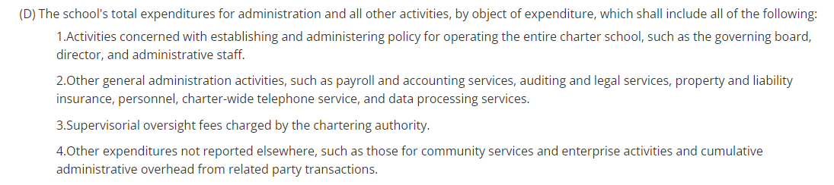
Page 2 through 4 – Financial Info

Slide 36
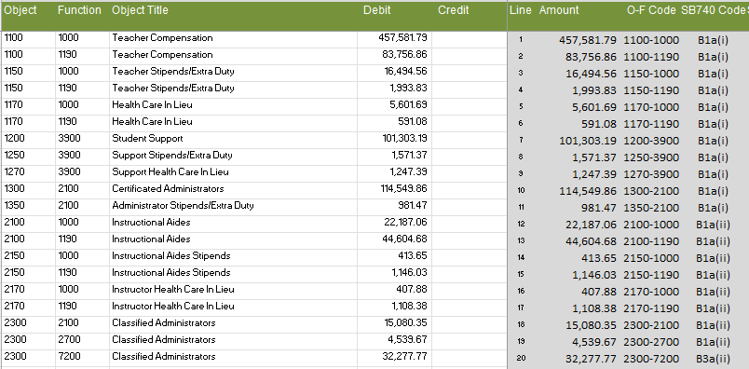
Page 2 through 4 – Financial Info
If using SACS coding….
Create a workbook that will group these into the specific categories utilized in the Funding Determination Form:

Slide 37
Page 2 through 4 – Financial Info
If not using SACS coding….
I would recommend tracking and tagging expenses throughout the year to save with the lift required when doing the Funding Determination Form (similar a restricted resource but utilizing a different segment). This can be done by utilizing Object Codes that would be instructional only or administrative only within allowable group codes. If not tracked during the year, you may need to peal apart by vendor/invoice to create both your functional report for audit and your FDF.

Slide 38
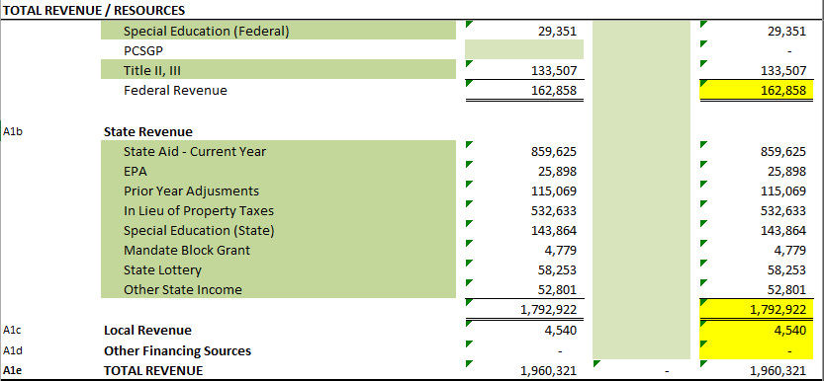
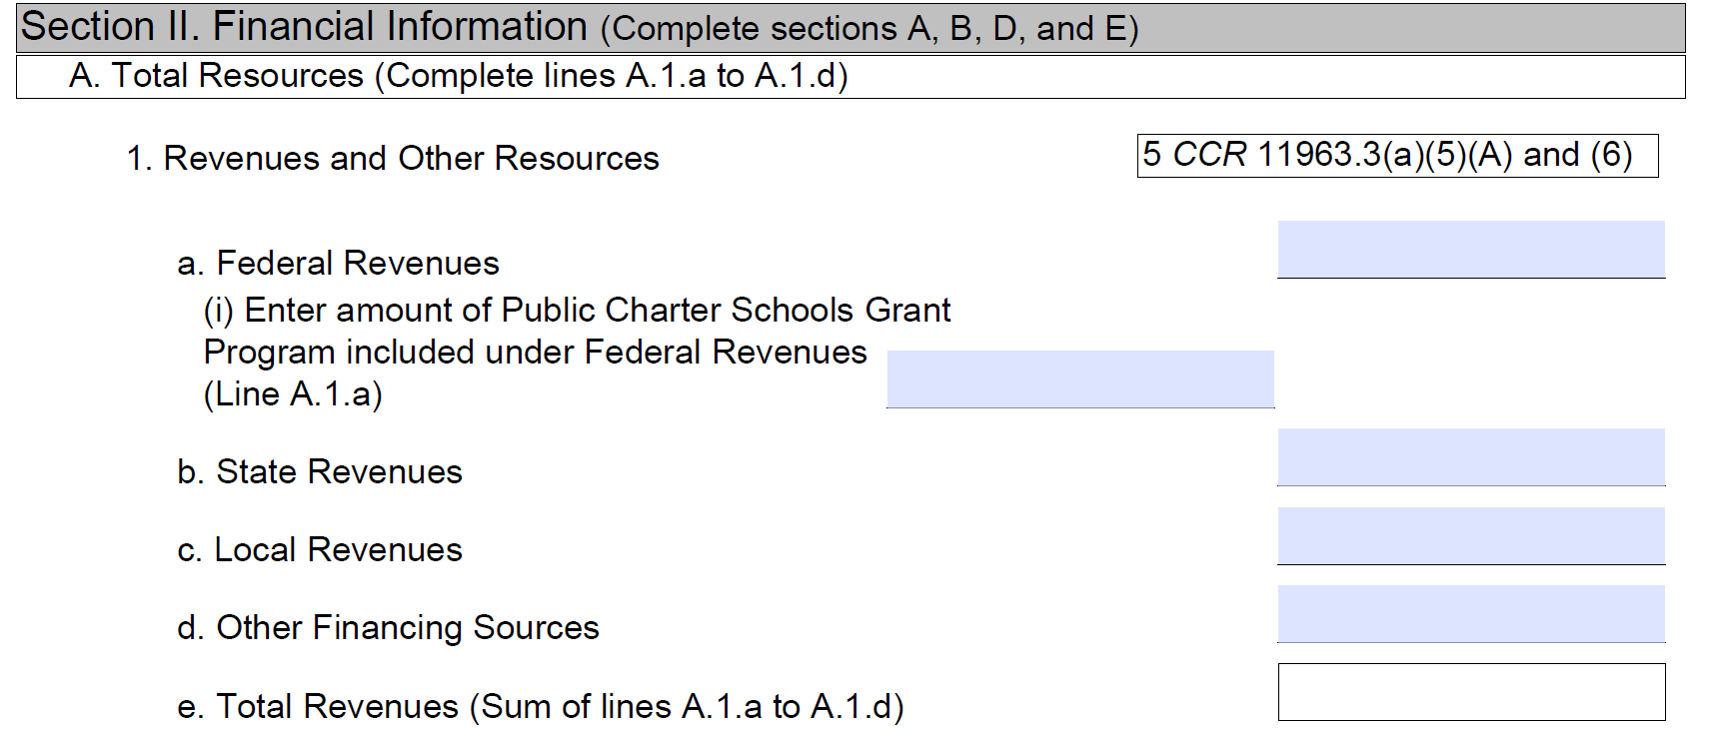
Page 2 through 4 – Financial Info
162,858
0
1,792,922
4,540
0
1,960,320

Slide 39
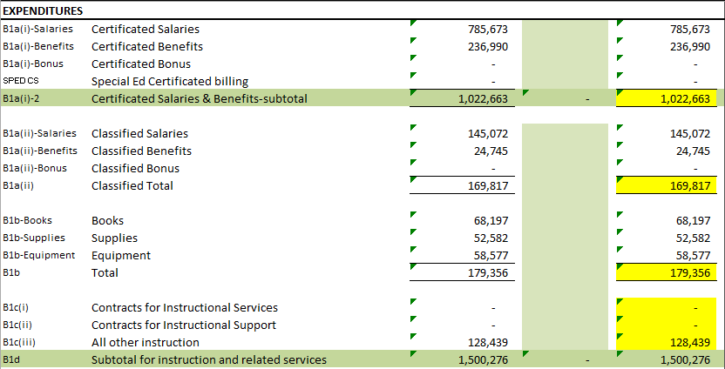
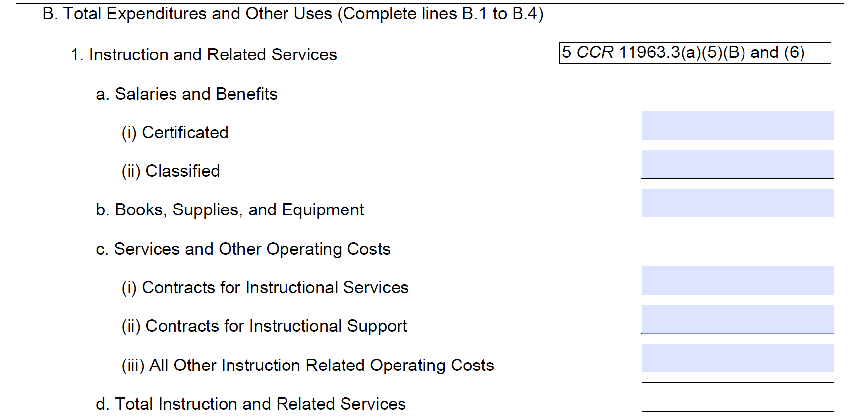
Page 2 through 4 – Financial Info
1,022,663
169,817
179,356
0
0
128,439
1,500275

Slide 40
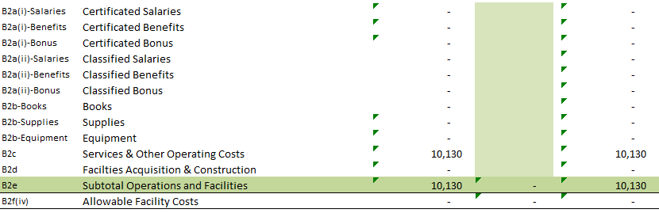
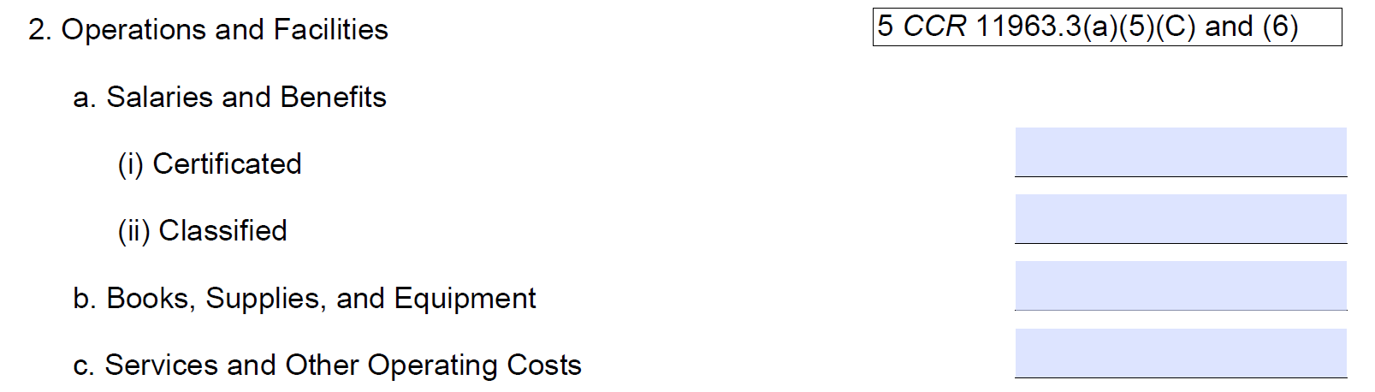
Page 2 through 4 – Financial Info
Allowable Facility Costs only apply to flex-based schools that have a seats-based element.
This would include independent study that have learning centers (and exclude home school and online programs)
0
0
0
10,130
0
10,130

Slide 41
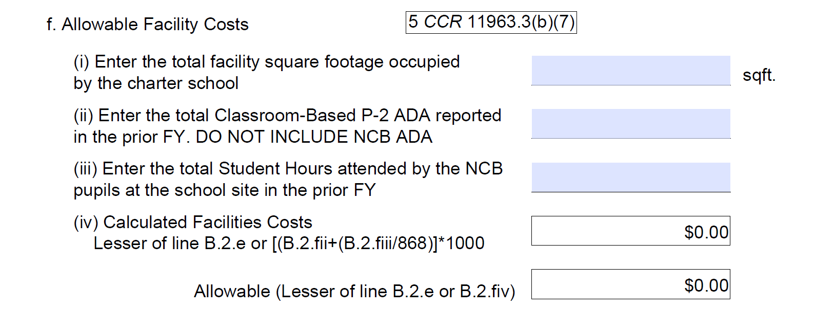
Page 2 through 4 – Financial Info
Allowable Facility Costs only apply to flex-based schools that have a seats-based element.
This would include independent study that have learning centers (and exclude home school and online programs)
This does not factor into the calculation. It is informational only
0
0
0
Allowable facility costs will take the lesser of the total facility costs and the calculation based on classroom hours

Slide 42
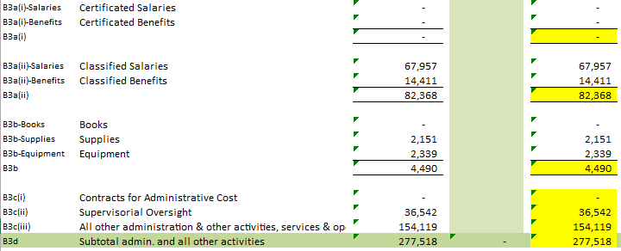
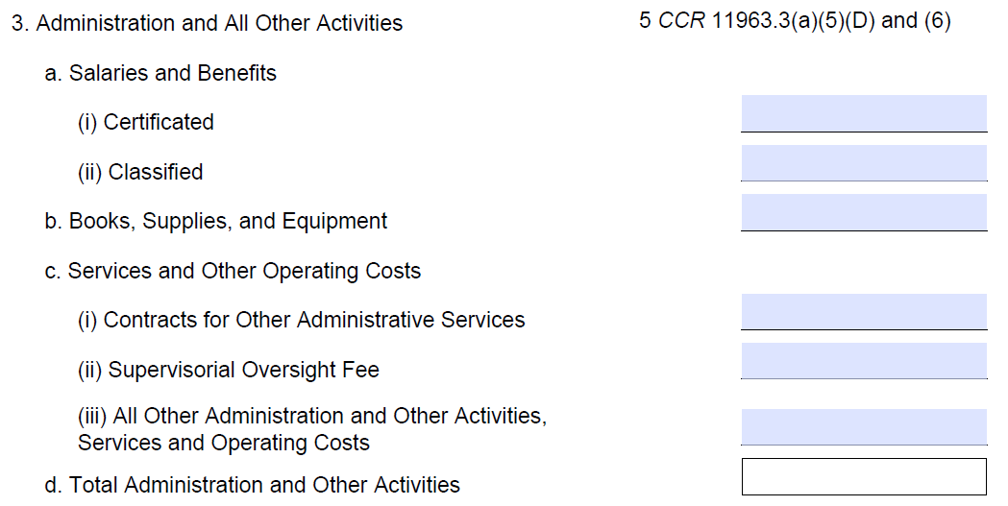
Page 2 through 4 – Financial Info
0
82,368
4,490
0
36,542
154,119
277,518

Slide 43
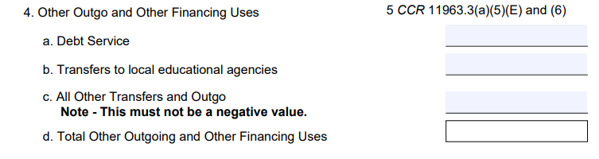
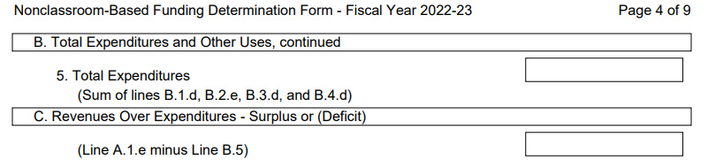
Page 2 through 4 – Financial Info
2,612
0
0
2,612
1,790,536
169,785

Slide 44
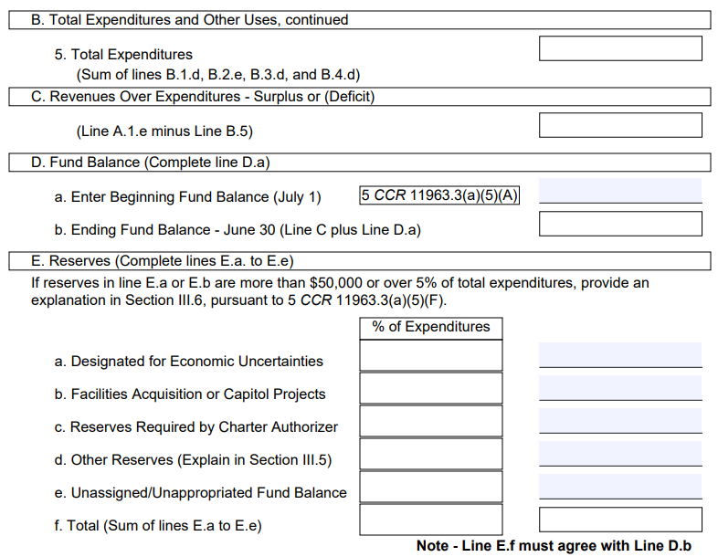
Page 2 through 4 – Financial Info
1,790,536
169,785
Pull from your audit report
500,000
669,785

Slide 45
Strategies for Fund Balance
Have a board approved Fund Balance / Reserve Balance Policy
Economic Uncertainty – This assignment represents an overall “safety net” for the School to cover a variety of unforeseen mid-term to long-term economic circumstances, including higher than expected outflows in any of the above three assignments. The onset of the COVID-19 pandemic in 2020 is an excellent example of how unforeseen events can require substantial reserves. Within a space of two months, the State budget chose to defer nearly 34% of state funding. While federal stimulus ended up mitigating some of this, there are no guarantees that future unforeseen impacts will be similarly mitigated. Designating thirty percent (30%) of the School’s fund balance for economic uncertainty represent the amounts necessary to protect the School from any combination of unforeseen revenue shortfalls, unexpected costs, and economic uncertainties.

Slide 46
Page 2 through 4 – Financial Info
1,790,536
169,785
500,000
669,785
Every 1% = 17,905
(1,790,536/100)
20%
358,100
5%
89,525
669,785 = 37.4%
(669,785/17,905)
12%
222,160
37%
669,785

Slide 47
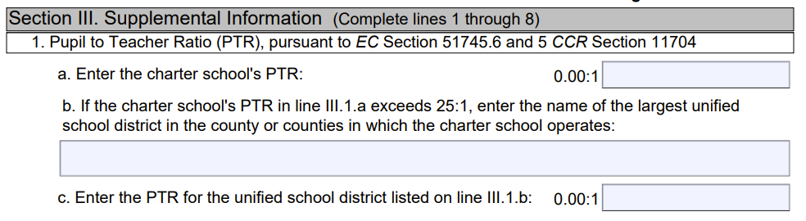
Page 2 through 4 – Financial Info
PTR (Pupil to Teacher Ratio) should be tracked throughout the year.
Take the average teachers over the course of the year
Utilize your P2 ADA
Sample Charter School:
P2 ADA: 156.56
Average Teacher FTE: 7.4
156.56/7.4 = 21.2
21.2

Slide 48

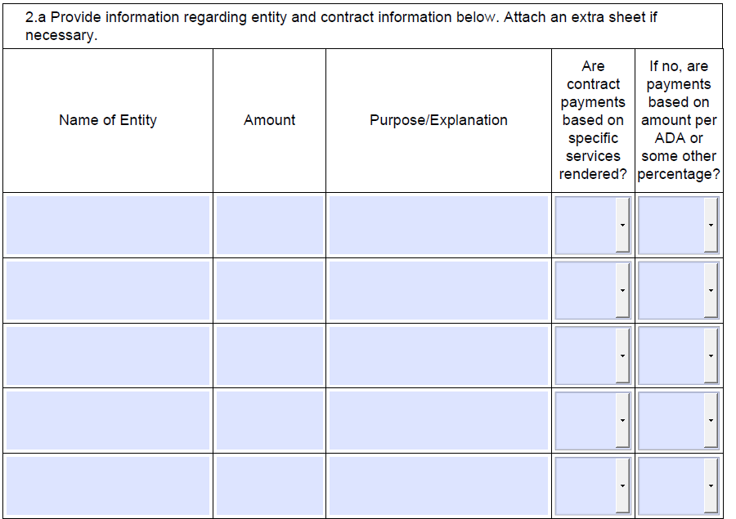
Vendor Disclosure
Run a Vendor for objects 4000 – 5999 and report all vendors above $50K (or 10% of total expenditures, if your total revenue is below $500K)
Amazon 56,489 Supplies Yes No
BookShark 55,345 Supplies Yes No
CDW 52,338 Supplies Yes No
Charter Imp 51,200 Accounting Yes No
Parsec Ed 56,703 Software Yes No

Slide 49
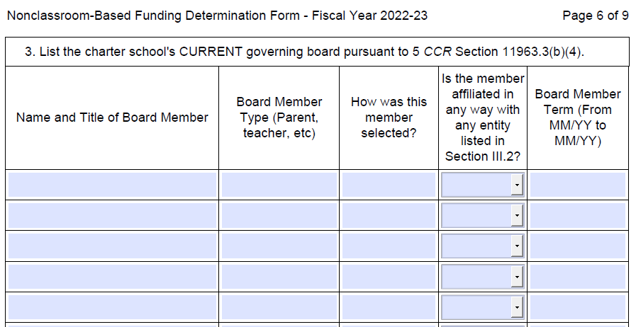
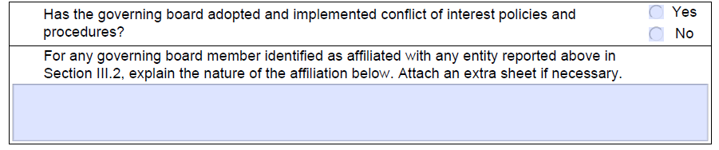
Board Disclosure
Seth Green, President Parent Appointed No 07/23-06/25
Wes Miles, VP Parent Appointed No 07/22-06/24
Josh Ramirez, Secretary Parent Appointed No 07/22-06/24
Janet Meyer, Member Parent Appointed No 07/23-06/25
Michelle Stanley, Member Parent Appointed No 07/22-06/24
N/A

Slide 50


Reserve Explanation
At the May 21, 2023, Sample Charter School board meeting, the board approved a fund reserve policy designating 20% of the school's fund balance to economic uncertainty. The onset of the COVID-19 pandemic in 2020 is an excellent example of how unforeseen events can require substantial reserves. Within a space of two months, the State budget chose to defer nearly 34% of state funding. 20% represents less than 2 ½ months for any unforeseen situation but gives the school a good foundation for time to find a solution.

Slide 51

Reserve Explanation
At the May 21, 2023, Sample Charter School board meeting, the board approved a fund reserve policy designating 7% as a SPED reserve and 5% for a legal reserve.

Slide 52


PTR
Refer back to the bottom of page 4:
Refer to your original budget:
156.56
215
Verify that your budget is PTR Compliant:
215/9 = 23.9 (which is less than 25)
7.4
9

Slide 53

Are you running a Virtual School?
Sample Charter School runs a home school program, so:

Slide 54


Did we make it?
Tracking is key:

Slide 55

Sample Charter School Qualifies for…

Slide 56


Mitigating Circumstances

Slide 57

Don’t forget to sign and send before 2/1

Slide 58
II. The cde, the accs, the sbe, and Mitigating Circumstances
Something to be avoid, if possible, but knowledge is power

Slide 59

ACCS and SBE Meetings

Slide 60

ACCS and SBE Meetings

Slide 61









ACCS and SBE Meetings

Slide 62
Mitigating Circumstances
5 CCR Section 11963.4(e) A reasonable basis for the Advisory Commission on Charter Schools to make a recommendation other than one that results from the criteria specified in subdivision (a) may include, but not be limited to, the following: the information provided by the charter school pursuant to paragraphs (2) through (8), inclusive, of subdivision (b) of section 11963.3, documented data regarding individual circumstances of the charter school (e.g., one-time or unique or exceptional expenses for facilities, acquisition of a school bus, acquisition and installation of computer hardware not related to the instructional program, special education charges levied on the charter school by a local educational agency, restricted state, federal, or private grants of funds awarded to the charter school that cannot be expended for teacher salaries, or contracted instructional services other than those for special education), the size of the charter school, and how many years the charter school has been in operation. The Advisory Commission on Charter Schools shall give charter schools with less than a total of one hundred (100) units of prior year second period average daily attendance or that are in their first year of operation serious consideration of full funding.
5 CCR Section 11963.4(e) A reasonable basis for the Advisory Commission on Charter Schools to make a recommendation other than one that results from the criteria specified in subdivision (a) may include, but not be limited to, the following: the information provided by the charter school pursuant to paragraphs (2) through (8), inclusive, of subdivision (b) of section 11963.3, documented data regarding individual circumstances of the charter school (e.g., one-time or unique or exceptional expenses for facilities, acquisition of a school bus, acquisition and installation of computer hardware not related to the instructional program, special education charges levied on the charter school by a local educational agency, restricted state, federal, or private grants of funds awarded to the charter school that cannot be expended for teacher salaries, or contracted instructional services other than those for special education), the size of the charter school, and how many years the charter school has been in operation. The Advisory Commission on Charter Schools shall give charter schools with less than a total of one hundred (100) units of prior year second period average daily attendance or that are in their first year of operation serious consideration of full funding.
5 CCR Section 11963.4(e) A reasonable basis for the Advisory Commission on Charter Schools to make a recommendation other than one that results from the criteria specified in subdivision (a) may include, but not be limited to, the following: the information provided by the charter school pursuant to paragraphs (2) through (8), inclusive, of subdivision (b) of section 11963.3, documented data regarding individual circumstances of the charter school (e.g., one-time or unique or exceptional expenses for facilities, acquisition of a school bus, acquisition and installation of computer hardware not related to the instructional program, special education charges levied on the charter school by a local educational agency, restricted state, federal, or private grants of funds awarded to the charter school that cannot be expended for teacher salaries, or contracted instructional services other than those for special education), the size of the charter school, and how many years the charter school has been in operation. The Advisory Commission on Charter Schools shall give charter schools with less than a total of one hundred (100) units of prior year second period average daily attendance or that are in their first year of operation serious consideration of full funding.
5 CCR Section 11963.4(e) A reasonable basis for the Advisory Commission on Charter Schools to make a recommendation other than one that results from the criteria specified in subdivision (a) may include, but not be limited to, the following: the information provided by the charter school pursuant to paragraphs (2) through (8), inclusive, of subdivision (b) of section 11963.3, documented data regarding individual circumstances of the charter school (e.g., one-time or unique or exceptional expenses for facilities, acquisition of a school bus, acquisition and installation of computer hardware not related to the instructional program, special education charges levied on the charter school by a local educational agency, restricted state, federal, or private grants of funds awarded to the charter school that cannot be expended for teacher salaries, or contracted instructional services other than those for special education), the size of the charter school, and how many years the charter school has been in operation. The Advisory Commission on Charter Schools shall give charter schools with less than a total of one hundred (100) units of prior year second period average daily attendance or that are in their first year of operation serious consideration of full funding.
5 CCR Section 11963.4(e) A reasonable basis for the Advisory Commission on Charter Schools to make a recommendation other than one that results from the criteria specified in subdivision (a) may include, but not be limited to, the following: the information provided by the charter school pursuant to paragraphs (2) through (8), inclusive, of subdivision (b) of section 11963.3, documented data regarding individual circumstances of the charter school (e.g., one-time or unique or exceptional expenses for facilities, acquisition of a school bus, acquisition and installation of computer hardware not related to the instructional program, special education charges levied on the charter school by a local educational agency, restricted state, federal, or private grants of funds awarded to the charter school that cannot be expended for teacher salaries, or contracted instructional services other than those for special education), the size of the charter school, and how many years the charter school has been in operation. The Advisory Commission on Charter Schools shall give charter schools with less than a total of one hundred (100) units of prior year second period average daily attendance or that are in their first year of operation serious consideration of full funding.
5 CCR Section 11963.4(e) A reasonable basis for the Advisory Commission on Charter Schools to make a recommendation other than one that results from the criteria specified in subdivision (a) may include, but not be limited to, the following: the information provided by the charter school pursuant to paragraphs (2) through (8), inclusive, of subdivision (b) of section 11963.3, documented data regarding individual circumstances of the charter school (e.g., one-time or unique or exceptional expenses for facilities, acquisition of a school bus, acquisition and installation of computer hardware not related to the instructional program, special education charges levied on the charter school by a local educational agency, restricted state, federal, or private grants of funds awarded to the charter school that cannot be expended for teacher salaries, or contracted instructional services other than those for special education), the size of the charter school, and how many years the charter school has been in operation. The Advisory Commission on Charter Schools shall give charter schools with less than a total of one hundred (100) units of prior year second period average daily attendance or that are in their first year of operation serious consideration of full funding.

Slide 63


Mitigating Circumstances – Example 1

Slide 64


Mitigating Circumstances – Example 2

Slide 65



Mitigating Circumstances – Example 3

Slide 66

Mitigating Circumstances
And then…. You wait….
The CDE might reach out with a few questions, or you may never hear from them….
Until their recommendations are post, which is only required 10 days before the ACCS Meeting
Approve
Approve
Deny
2
Deny
1
Approve
Approve
Approve
Deny
Approve
*Can only be approved for 2-years with mitigating circumstances*

Slide 67
www.charterimpact.com
OFFICE:
888.474.0322
8500 Balboa BlvD., SUITE 140
Northridge, CA 91325

